Slide 1
Study of High Gradient Acceleration in Normal Conducting Accelerator
US-Japan workshop
Dec. 20, 2011
Toshi Higo (KEK)

Slide 2
Contents
Mission of the study
State of the art
What prevents us from high gradient
Trial to understand physical mechanism
How to develop the technology
Contribution based on US-Japan program

Slide 3
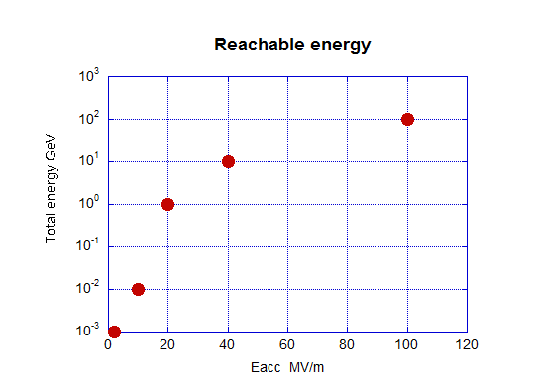
Toward higher energy
Gradient in normal conducting accelerator
Low energy application
  100kW, a few MV/m, 1MV
Medium energy application
  1MW, 10MV/m, 10MV
Established big accelerator
  a few 10MW, 20MV/m, 1GeV
On-going high energy machine
  40MW, 40MV/m, 10GeV
Very high energy machin
  50MW, 100MV/m, 100GeV

Slide 4
Target gradient for LC and required stability
1990’s at 100MV/m, 20cm
  “gradient established” in short section
  No care on BDR etc.
2000’s at ~50MV/m, 60cm
  HOM managed
  Damage observed but BDR meets req.
2010’s at 100MV/m, 25cm
  Targeting the regime 100MV/m
  Stability: 1BD/structure/3days

Slide 5
Mission of high gradient study
Understand vacuum discharge mechanism
  Trigger mechanism
  Evolution to discharge over big volume
  Damage mechanism
Search for suppression technology
  Material, geometry, processing method, …..
Serve for
  Stable acceleration for present machines
  High energy accelerator such as LC

Slide 6
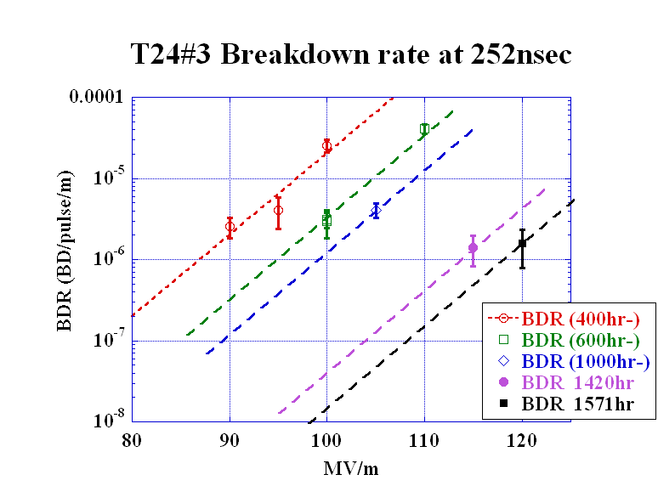
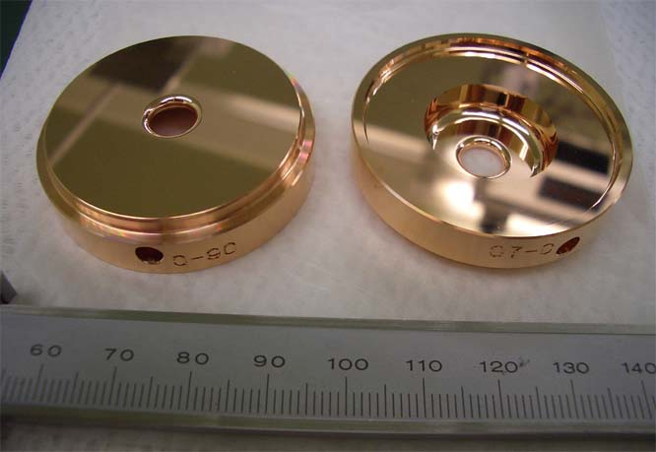
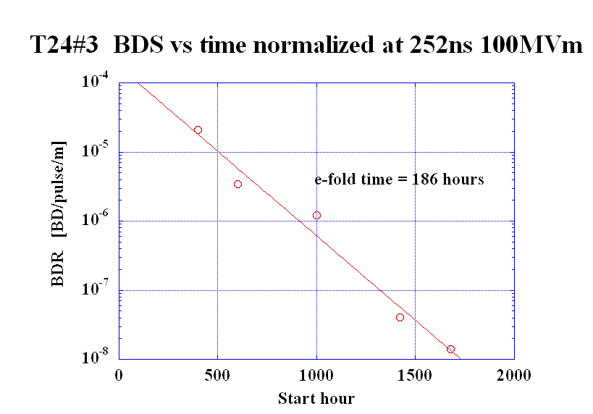
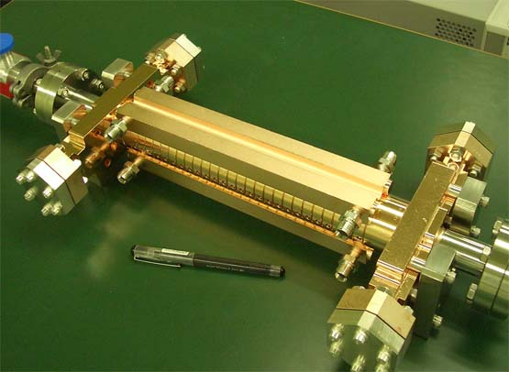
State of the art for LC in undamped
Speculated from higher gradient data
BDR decreases continuously over a few thousand hours.
It meets the requirement of a linear collider, CLIC.

Slide 7
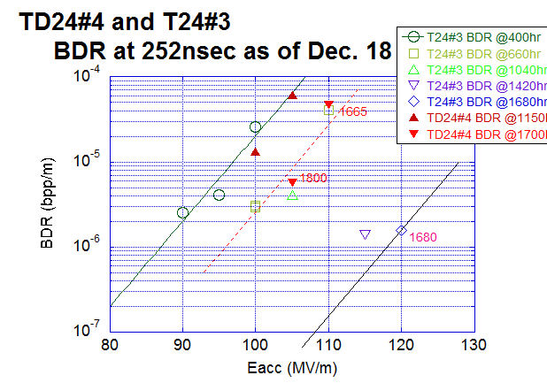
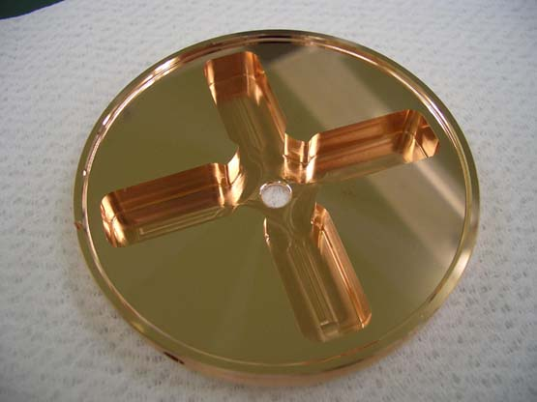
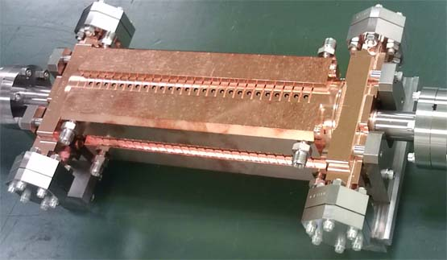
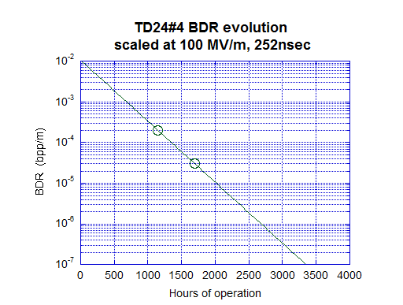
State of the art for LC in damped
More BDR in damped than undamped, but BDR decreases as time. We are on the edge? → Need to understand and confirm!

Slide 8
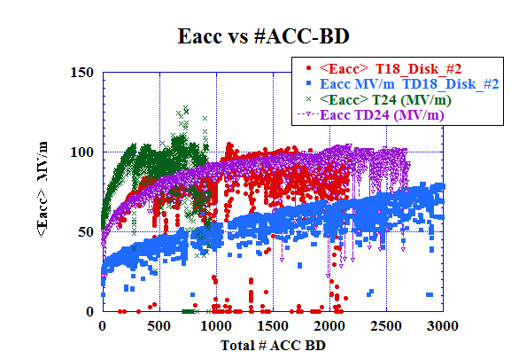
Difference of #BD until reaching goal
BD can be needed or avoided?
Undamped
Damped
More BD’s are required for damped!?
Why?
Can it be reduced?
BD’s are essentially needed?

Slide 9
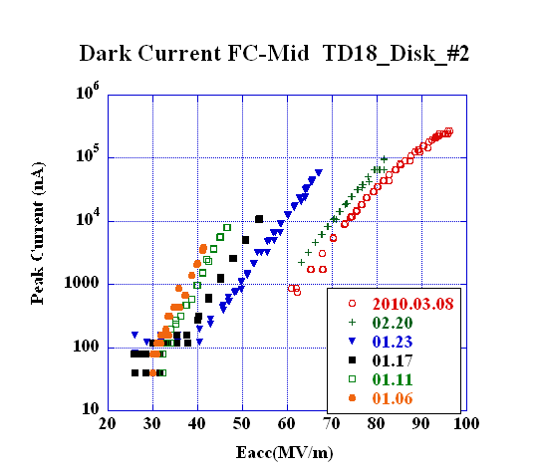
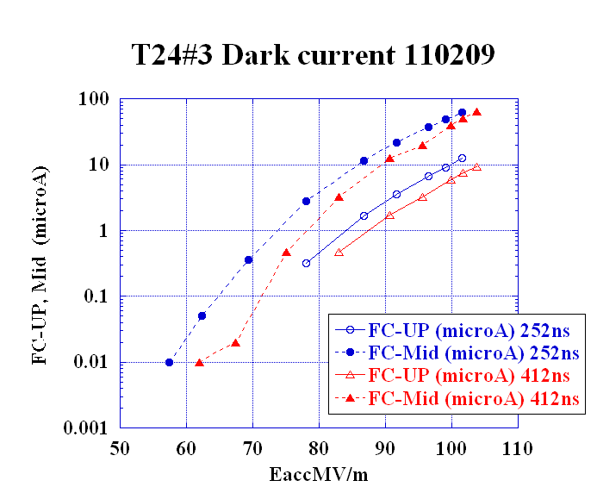
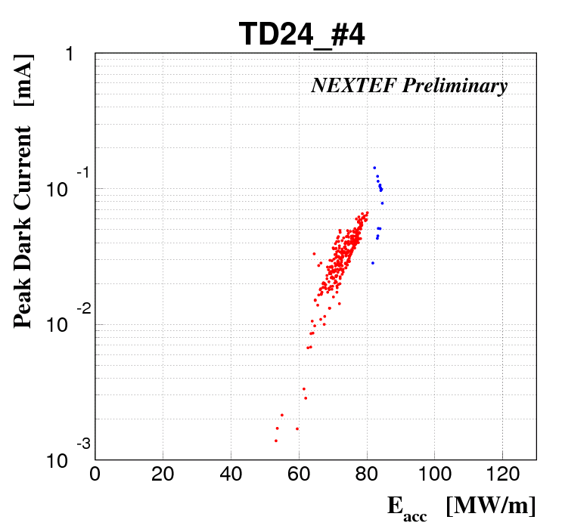
Field emission seems related to high gradient
TD18_Disk
worst
T18_Disk
T24_Disk
best
TD24_Disk
(51ns processing)
Eacc for peak dark current of 10 μ
90MV/m 70MV/m 100MV/m (80MV/m)
Need to understand the relation between the two.

Slide 10
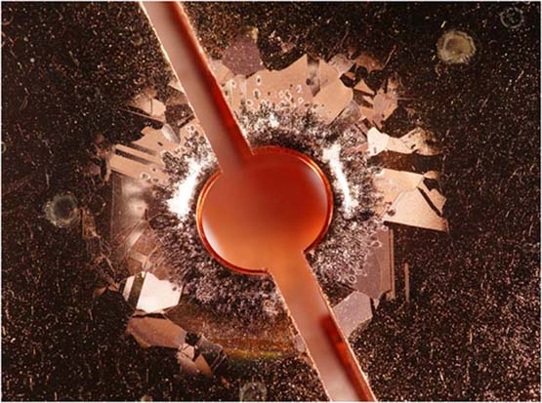
Discharge pits around iris +
Crystal pattern by pulse surface heating.
Photo John Van Pelt
Notes:
試験したセルは
アイリス近傍に 放電によるアーク放電ピット 多数
温度上昇があると
外側は結晶構造、方位による表面の荒れのパターンが見える
→ この辺りが、放電頻度を決める因子を持っていると思われる（仮定に過ぎないが）

Slide 11
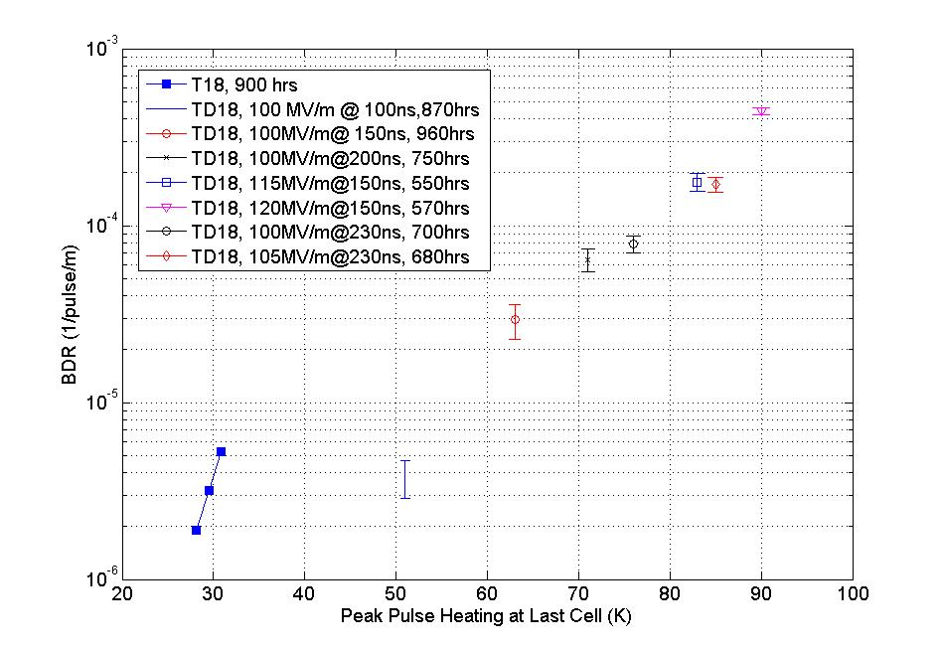
Breakdown rate vs pulse heating
Faya Wang
TD18 BDR
Damped
Undamped
ΔT ~ H_{s}²
ΔT
BDR closely correlates to pulse temperature rise
Notes:
温度上昇をパラメータとすると
放電頻度が統一的に見えてきた

Slide 12
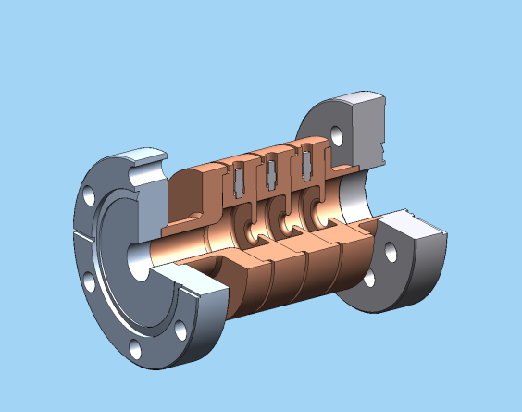
Importance of magnetic field
V. Dolgashev, AAS 2010
Surface electric field
Magnetic field
Accelerator gradient
Pulse surface heating
Peak pulse heating plays an important role, rather than geometry.
Notes:
どの構造でも
単純なパルスでは
磁場、又は相当する温度上昇 のみで 放電頻度が決まっている
但し、 150MV/m 級の加速電界、放電頻度は非常二大きい 場合の特徴である

Slide 13
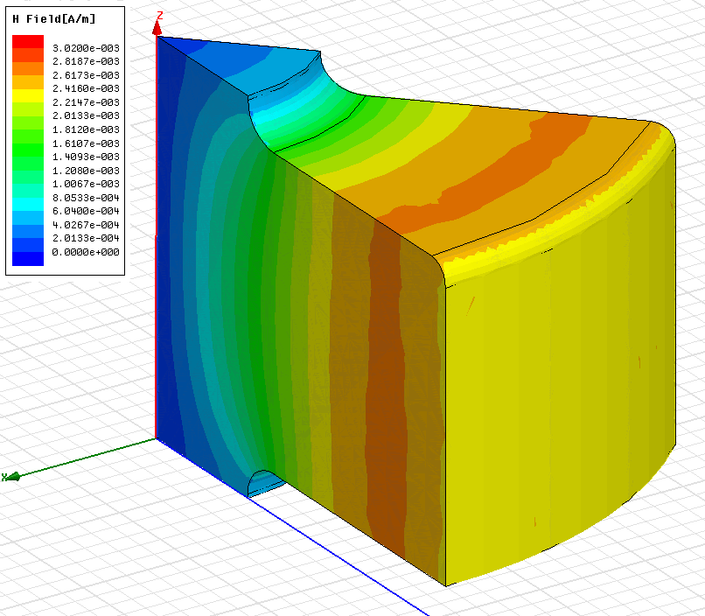
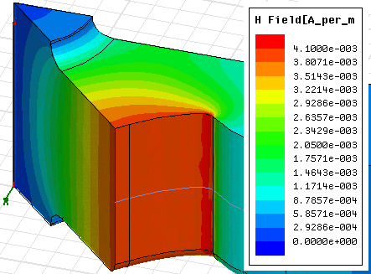

Undamped → damped
Param. | Unit | T24 | TD24
<Eacc> | A/m | 100 | 100
Es/Ea | 1 | 1.95 | 1.95
Es | MV/m | 195 | 195
Hs/Ea | mA/V | 2.6 | 4.1
Hs | kA/m | 260 | 410
Hs

Slide 14
Breakdown trigger comes from
high magnetic field area?
Strange shape appears at highest Hs point.
Pulse heat damage
Surface current is large!
400kA/m over 0.5μm thick
1A/μm²
>> IC problem
(~0.1A/μm²)
Hs max
→ High current
Markus Aicheler 13. Oct. 2010

Slide 15
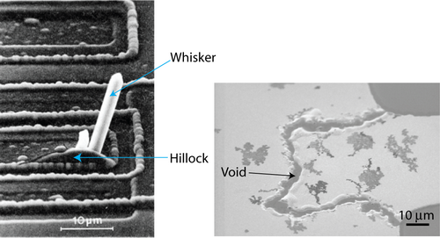
Electromigration?
Taken from web: University of Cambridge.
Direct electric field
a=screening factor
F_{d} = aZeE
Diffusion process
Conduction electron wind
Q=Activation energy
σ=collision cross section
λ=mean free path
D = D₀ exp (–Q/RT)
F_{w} = –en_{e}λσ_{i}E
Crystal defect, boundary, void, etc. are related

Slide 16
What limits high gradient is:
Arc, Discharge, Breakdown, …. In vacuum
Appears in such as
  Processing
    Period needed until reaching goal
    How many BD’s are needed to reach goal
  Breakdown
    Luminosity loss, material damage
    Requirement of spare units recovery time
  Damage
    Cumulative damage perturbs frequency

Slide 17
We need to understand physical mechanism of vacuum arc
Possible and proposed mechanisms
  Sharp edge → Es enhancement → FE
  Es → Maxwell’s stress → pull up crystal → FE → plasma development
  Hs → pulse heating → fatigue → edges and ruptures → high Es
  Hs → high current density → electromigration
BD Trigger and evolution to discharge
  Understand mechanism
  Estimate degree of damage

Slide 18
How to study mechanism and develop suppression technology
Prototype test
  GLC/NLC → CLIC
Study with simple geometry
  Single-cell setup, waveguide, DC, etc.
Developments in the area such as
  Geometry, fabrication, assembly technique
  Processing method

Slide 19
Keys studies supported by US-Japan
KEK
  Parts fabrication
  Long-term high gradient test
SLAC
  Chemical polishing and assembly
  Hydrogen furnace and vacuum baking
  Very high power test
  Various specific tests
US high gradient collaboration
  Exchange of ideas and experimental results
  Specific tests in special conditions and environments

Slide 20
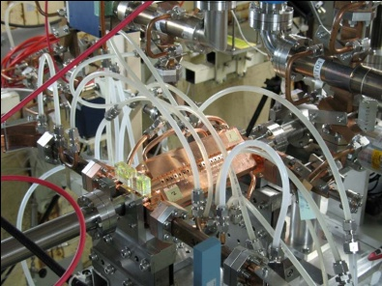
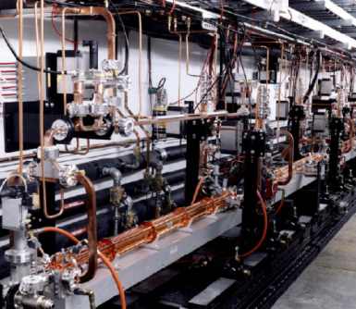
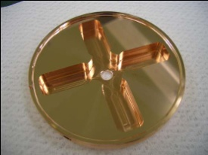
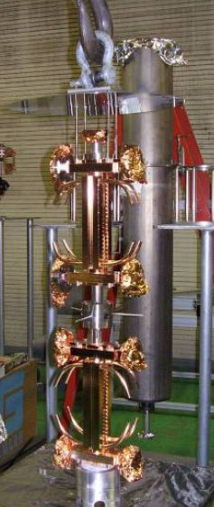
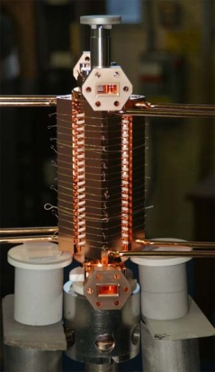
SLAC/KEK prototype test flow
Design for CLIC (CERN)
High power test (NLCTA-SLAC)
High power test (Nextef-KEK)
Fabrication of parts (KEK)
CP (SLAC)
VAC bake (SLAC)
Bonding (SLAC)
Notes:
プロトタイプの試験サイクル
ここでも 日米を基礎におく SLAC・KEK キープレーヤー

Slide 21
What to be studied toward future
Explore basic studies (KEK and SLAC)
Continue evaluation of prototype structures (KEK and SLAC)
Understand structure whole life and improve processing (KEK)
  Initial ramp up stage
  Establish target operation
  Stability through long-term operation
Study feasibility of much higher gradient (SLAC)
  SW approach and material approach
  To understand practical operation regime

Slide 22
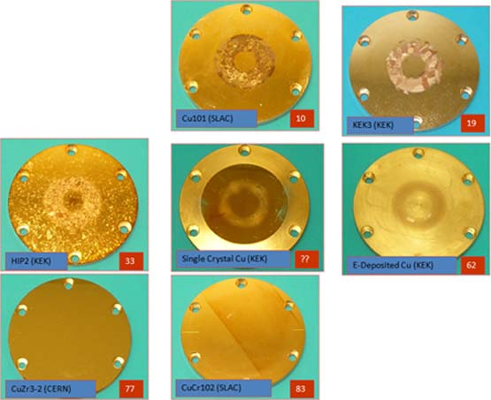
Pulse heating and surface deterioration
(done)
Hard material is better.
SLAC: L. Laurent
Hardness Test Value

Slide 23
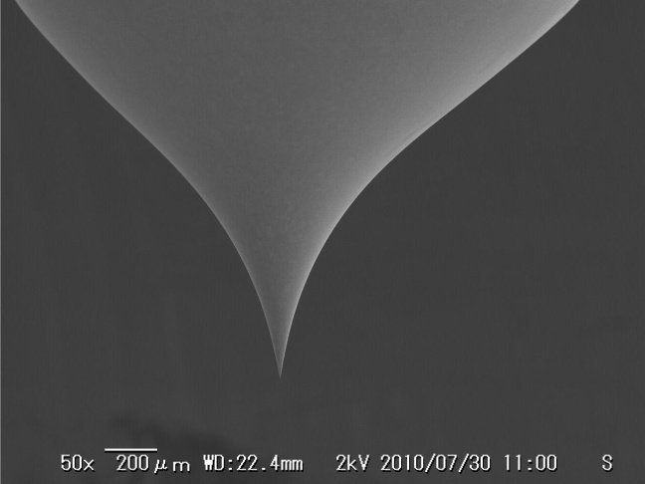
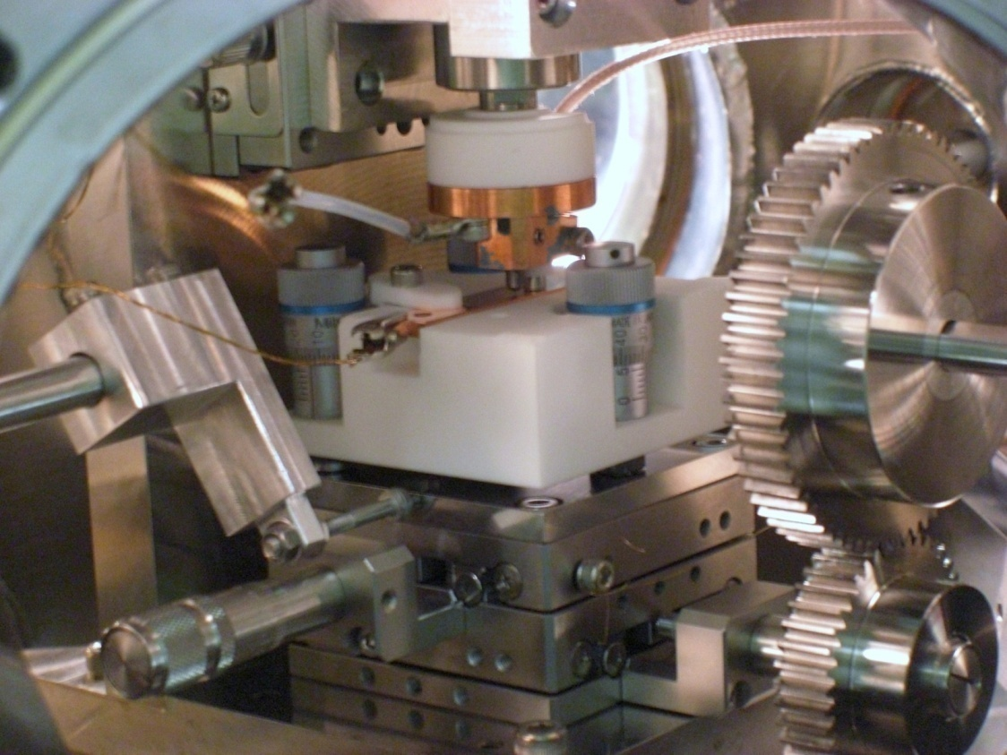
Scanning field emission microscope
PIEZO actuator
Capacitance gauge
W-Tip
W-Tip
Sample
XY stage
Field emission and surface of crystal characteristics.

Slide 24
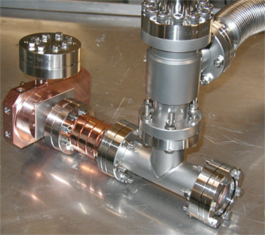
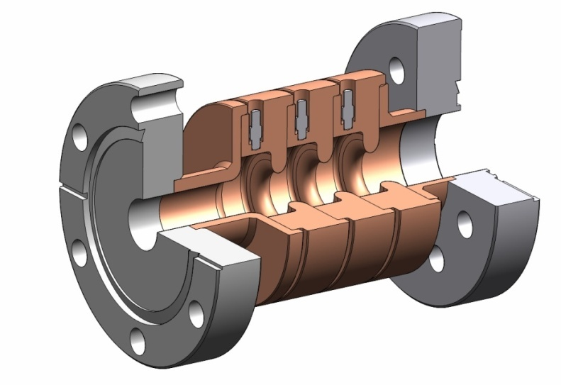
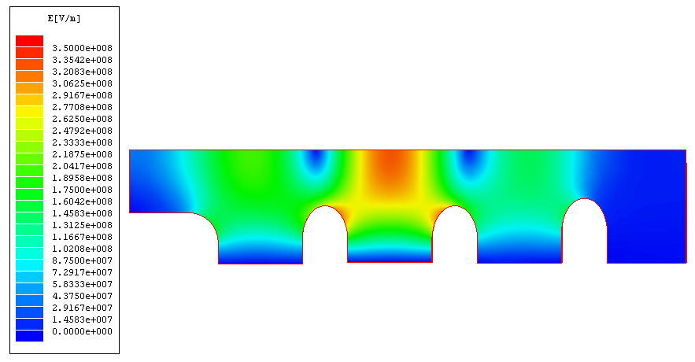
Study with single-cell setup
Clean setup
High field at center cell
Test setup at SLAC

Slide 25
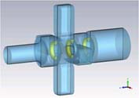
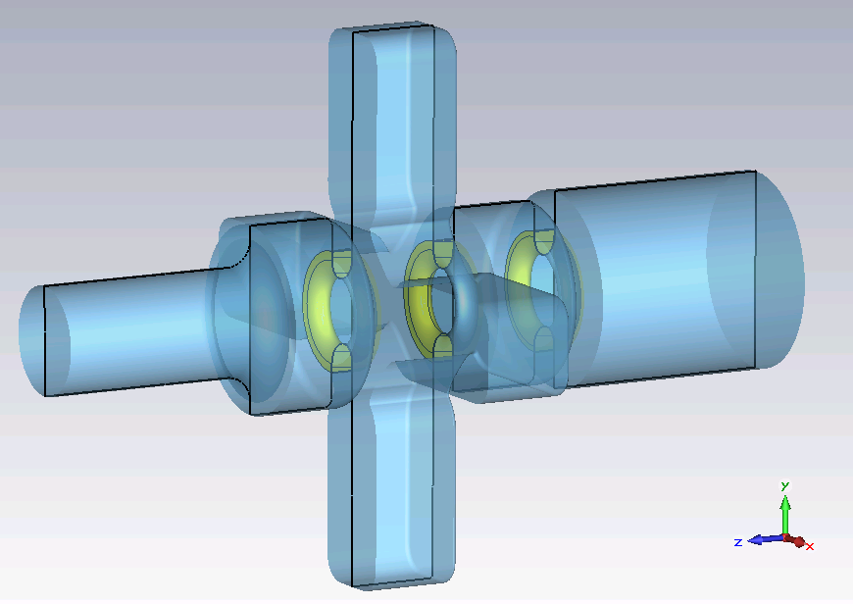
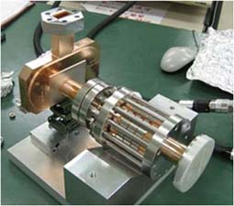
Study damped cell
Iris can be Cu, Mo, SS
Test setup being prepared at KEK

Slide 26
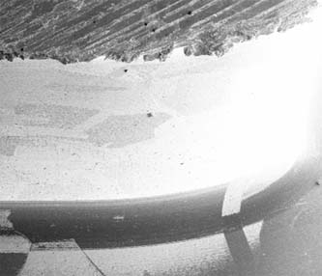
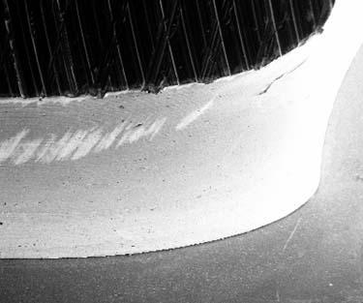
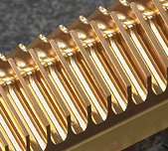
Thinking of possible trails
Diffusion bonding → Brazing → Clamped ?
1μm
1μm
Downstream side
Diffusion-bonded surface
→ may be improved by
brazed smooth surface
No further enhancement
of current
Upstream side
Milled surface
Crystal defects OK?
Revisit quadrant?
→ divide along
current path
No current interruption

Slide 27
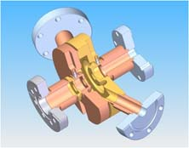
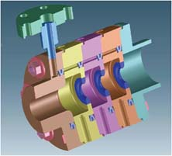
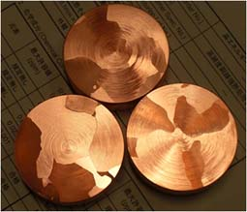
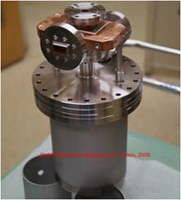
Other on-going basic tests
In-situ inspection
Clad (Cu/SS, Cu/Mo)
Large grain material
Crystal characteristics
Cu and Nb in cold setup
Notes:
SLACの単セル試験
In-situ の表面観測 Processingの理解を深める

Slide 28
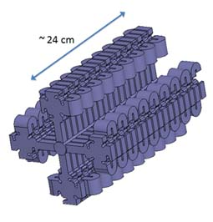
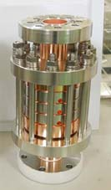
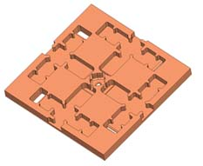
Toward much higher gradient
SW study at SLAC
Cu/Moly clamp by KEK
Notes:
SLACで進めている SW ベースの設計
今後 高電界試験へ進めていく

Slide 29
Conclusion
Basic studies and prototype evaluations are performed in cooperative manner between US and Japan.
It offers essential understanding for the high gradient realization based on copper.
Magnetic field and associated high current on a crystal structure play an important role.
Trigger mechanism of breakdown should be understood through studies with simple setups.
US pursuits real high gradient while Japan evaluates up to 100 MV/m. These studies are complementally and offer a baseline idea for linear collider application.

